Slide 1
Habit – User’s Recently Played Tracks
Daniel Chaves

Slide 2
About the project
The main project's purpose is to integrate the Spotify for Developers API, similarly to creating an elegant and optimized User Interface, with a unique feature: User's Recent Played Tracks.

Slide 3
CHALLENGES THAT I’VE FOUND
SPOTIFY API FLOWS
HARDWARE/FETCHING COSTS
Beautiful and rich, the Spotify documentation can be way complex. Understanding the API design and structures was a challenge for me, but the response is almost always in the details.
This application contains only 2 states. I was always worried about creating an application that really rerenders when necessary.
USABILITY
MAINTAIN STATE RENDERING
User Experience and User Interface approach to bring to the user the best experience, such as Debouncing Input (also optimizing point), toasts for each core functionality, and fetching UI loading cover.
Since dealing with fetching and searching, it is common to have many state renderings. Heads up at useCallback/useMemo/useEffect hooks.
LAZY LOADING
Lazy loading bothers us to create a full-controlled indexing list. It can be hard to manage sometimes and required more time to do so.

Slide 4
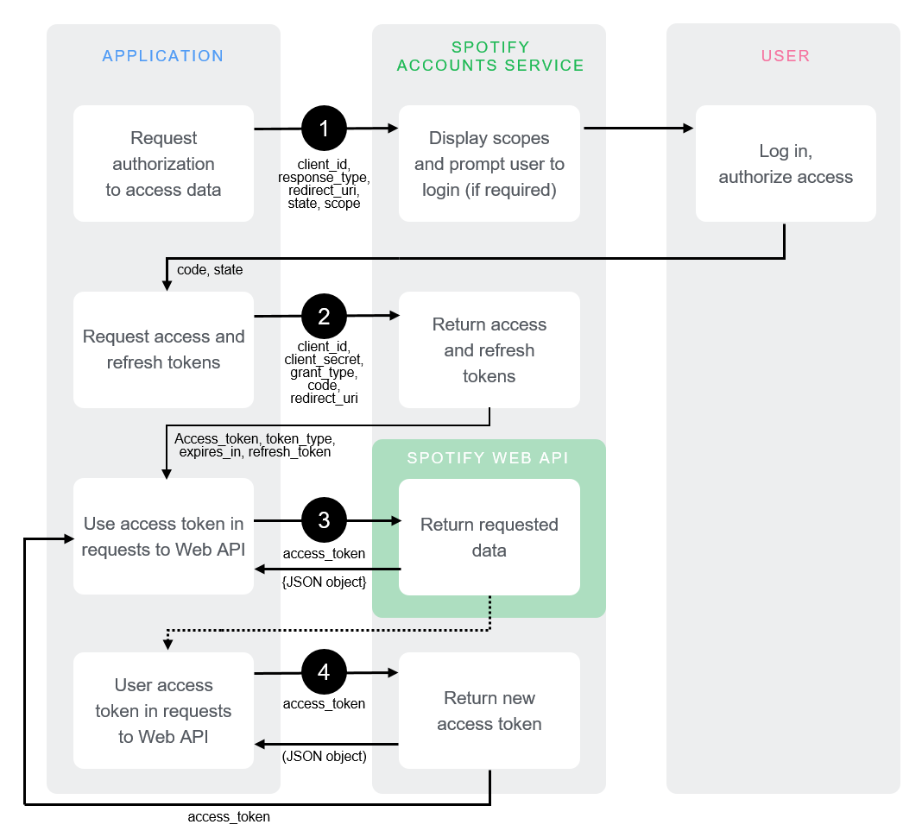
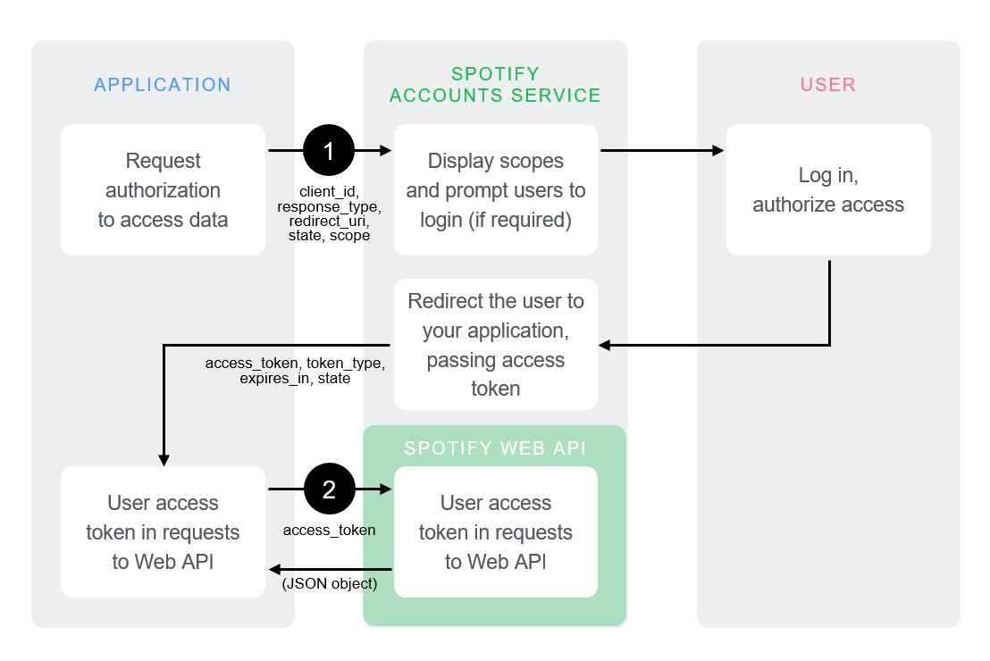
SPOTIFY AUTHORIZATION CODE FLOW
AUTHORIZATION CODE FLOW
The authorization code flow is suitable for long-running applications (e.g. web and mobile apps) where the user grants permission only once.
IMPLICIT GARANT FLOW
The implicit grant flow is carried out on the client side and it does not involve secret keys. Thus, you do not need any server-side code to use it. Access tokens issued are short-lived with no refresh token to extend them when they expire.
CLIENT CREDENTIALS FLOW
The Client Credentials flow is used in server-to-server authentication. Since this flow does not include authorization, only endpoints that do not access user information can be accessed.

Slide 5
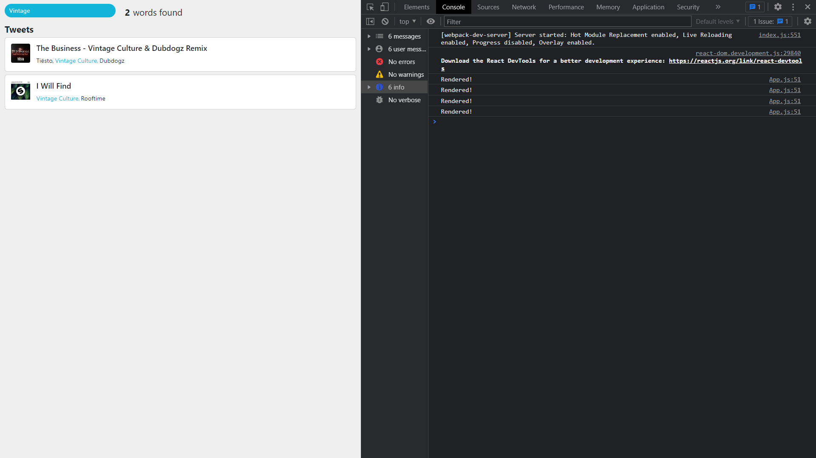
MAINTAIN STATE RENDERING
HARDWARE FETCHING COSTS
There is a console.log(‘Rendered!’); at App.js outside the return method.
This means that every time the App rerenders, the logging will be called.
Searching for “Vintage” at the Search bar, we can see 4 renders.
1. The start render;
2. The fetching API Tracks State Mounting render;
3. The first letter render (User Experience);
4. The debounce input maintains the next render until the user types the last character (300ms for character).

Slide 6
PROMISING
The project can approach different services, such as managing data structures and specific data that aren’t fully visible to common users, in Spotify App:
GEOGRAPHIC DATA
POPULARITY DATA
ARTISTS DATA
ALBUM DATA
HISTORICAL DATA
... And many others

Slide 7
Libraries and best practices

Slide 8
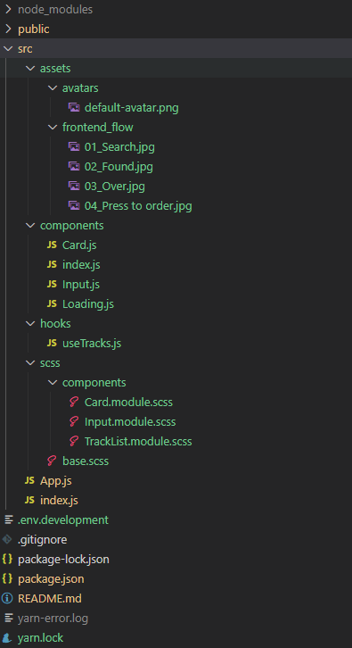
LIBRARIES AND BEST PRACTICES
Chosen libraries and practices
Dependencies
Additional Information
bootstrap: "^5.2.0"
react-bootstrap: "^2.5.0“
sass: "^1.54.4"
classnames: "^2.3.1"
react-beautiful-dnd: "^13.1.0"
react-debounce-input: "^3.3.0"
react-hot-toast: “^2.3.0”
SASS is highly recommended to use with Bootstrap (plus sass modules);
Classnames library is mainly used to control class conditions;
dnd/debounce/toast: developers’ famous phrase: “we don’t want to reinvent the wheel”.

Slide 9
Future enhancements:
Lazy loading in the list to reduce the size of the albums’ image request (only when scroll);
Image minification to reduce the size of the albums’ image request UI mounting;
Cache to store already loaded data, such as ‘useQuery’ from ‘React-query’;
Virtualize the list (not only lazying loading it, but replacing their nodes mounting/unmounting the React Reconciliation as a user dynamically scrolls through the items);
E2E Tests;
Unit tests;
API Integration tests;
Habit - User's Recent Played Tracks

Slide 10

Thank you!
Daniel Chaves​
Software Engineer
daniel.cassiano@live.com
github.com/danielcassiano

